Slide 1
UNIT-II: Public Key Cryptography and RSA
By
Dr. Ch. Sita Kumari

Slide 2
Public Key Cryptography
Chapter-2:PUBLIC-KEY CRYPTOGRAPHY AND RSA:
Principles of Public-key cryptosystems,
Applications for Public-key cryptosystems,
Requirements for Public-key cryptography
Public-key cryptanalysis
The RSA Algorithm.
Description of the Algorithm
Computational Aspects
The Security of RSA
Chapter-3:OTHER PUBLIC-KEY CRYPTOSYSTEMS:
Diffie-Hellman key exchange,
Elgamal cryptographic system,
Elliptic curve arithmetic,
Elliptic curve cryptography

Slide 3
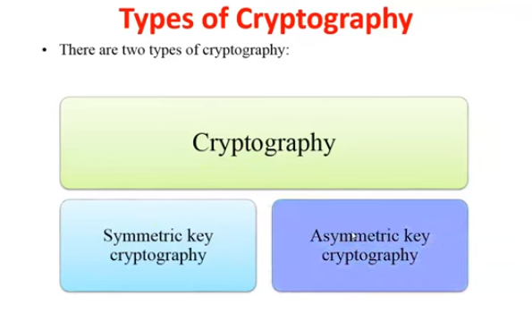

Slide 4
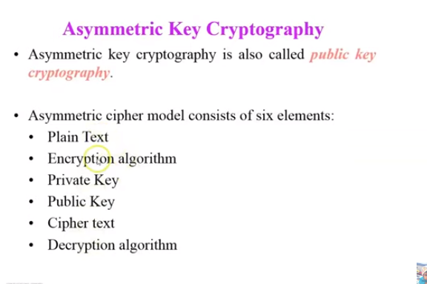
Terminology

Slide 5
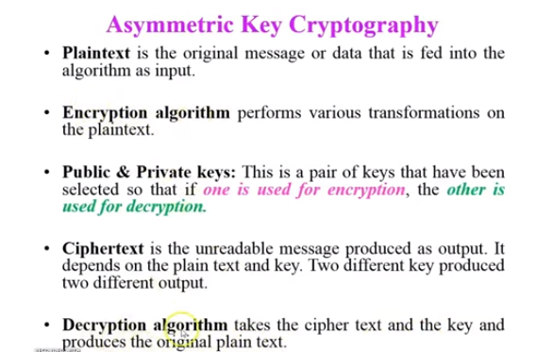

Slide 6
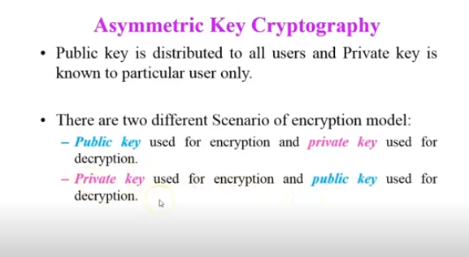
Scenarios for encryption and decryption

Slide 7
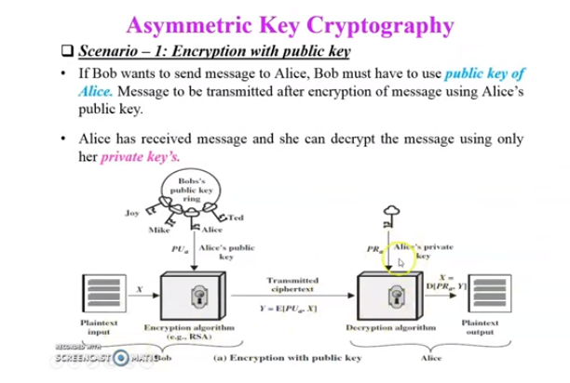
Encryption with public key

Slide 8
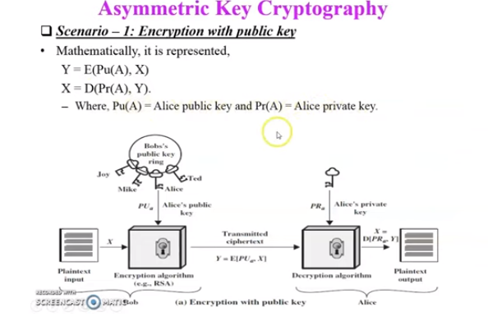

Slide 9
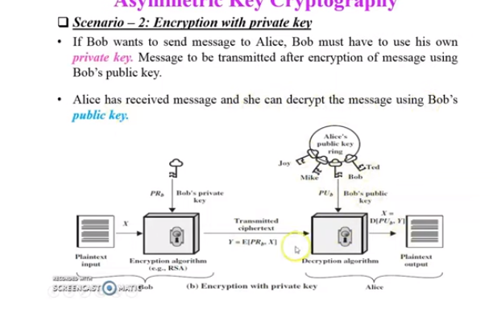

Slide 10
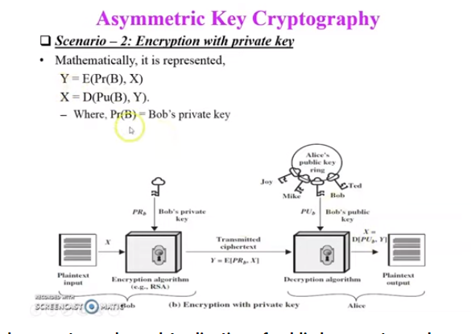
Encryption with private key

Slide 11
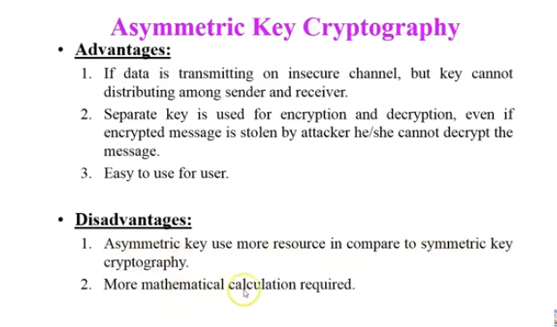

Slide 12
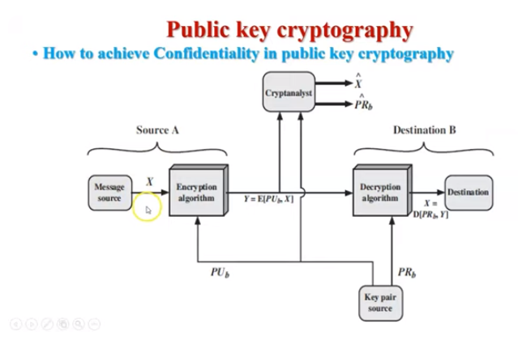
Applications

Slide 13
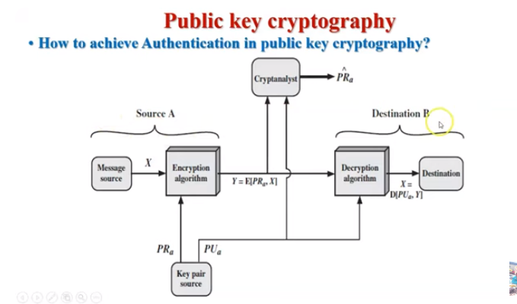
Notes:
X bar is estimation plaintext

Slide 14
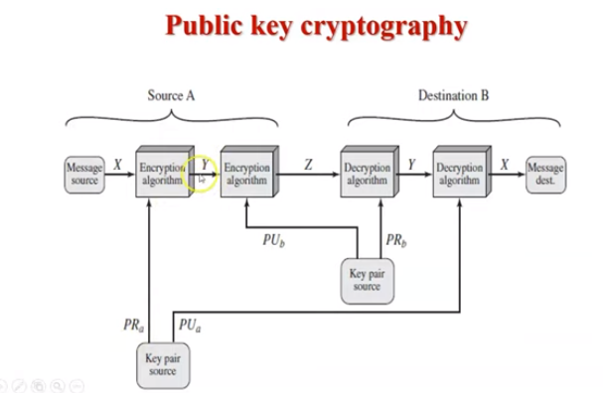
Authentication with security

Slide 15
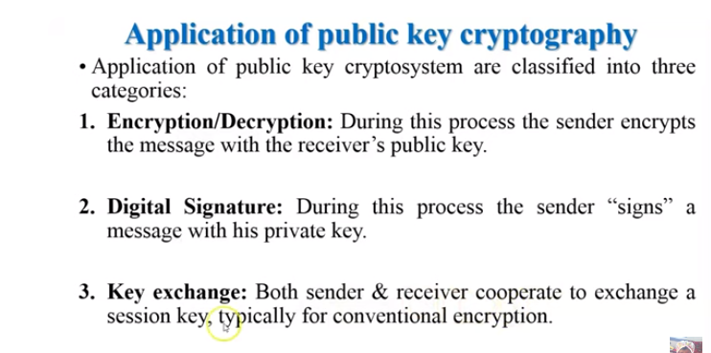

Slide 16
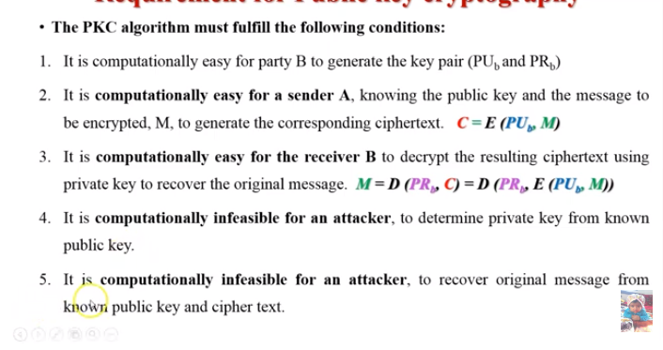
Requirements for Public key Cryptography

Slide 17
